Slide 1
Personas and user stories
Backlog and sprints
Hannu Markkanen, Amir Dirin

Slide 2
Who are the users, why and how they would use your application?
Persona - fictive or research based description of a typical user.
User story - what the user would like to accomplish, why and how does one know the application does what the user wanted to do

Slide 3
Personas and user stories as tools for requirement capture
Idea -> identify user groups -> personas -> user stories -> product backlog
persona
Application idea
Product backlog
persona
persona

Slide 4
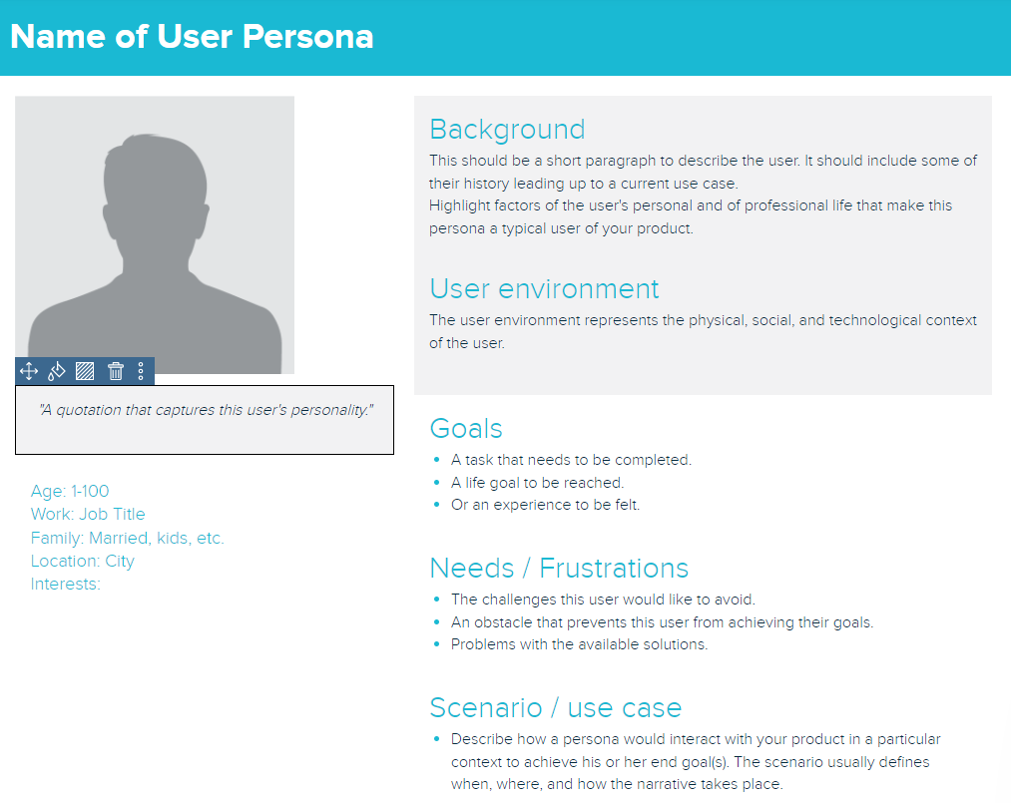
Personas
Representation of the goals and behavior of a hypothesized group of users
Synthesize data collected from interviews with users
Captured in one or two-page document that include background, goals, needs, as well as the environment in which a persona operates

Slide 5
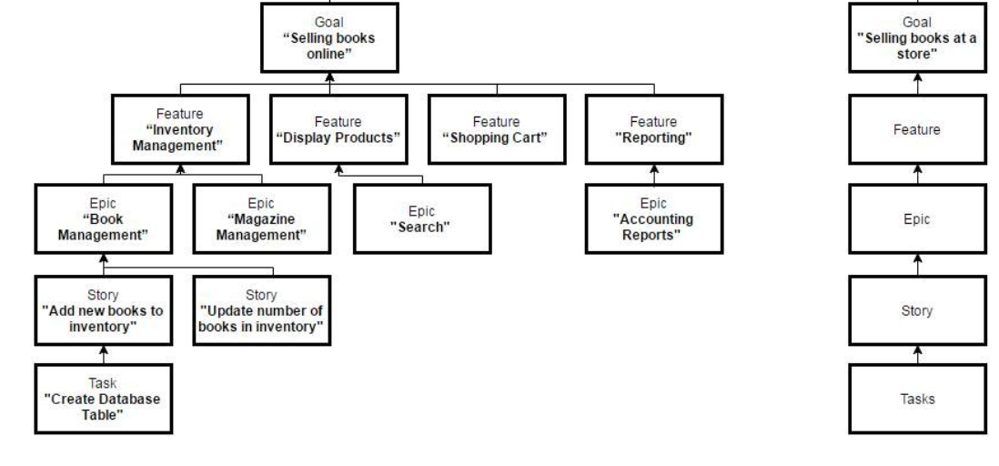
User stories, epics and features
https://www.linkedin.com/pulse/definition-agile-feature-mike-burns/

Slide 6
User story captures a requirement: Who, What, Why
a concise description of a piece of functionality that will be valuable to a user or owner of the software
As a [type of the user / persona] I want [to do something] so that [I can achieve a goal]
Should be written in language that the user understands.

Slide 7
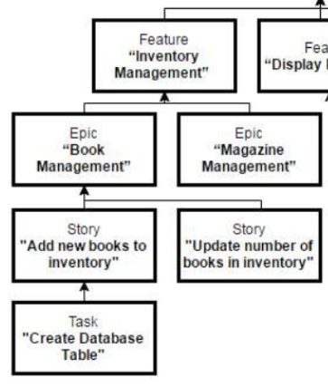

User stories - examples
Epic: Book management As a inventory manager, I want to control the inventory of the books in our warehouses, so that I can ensure that there is enough stock to meet demand without excess inventory.
User story: Add new books to inventory As a inventory manager, I want to add a new book to the inventory, so that a new arrival can be included in our web shop for purchase.
User story: Update number of books in inventory As a warehouse clerk, I want to update the number of a books in inventory, so that the received items are correctly registered in the warehouse system.

Slide 8
User stories are used as a basis for app development
Who - description of the user
What - describes the functionality user wants => design & implementation
Why - what the user wants to achieve => test acceptance criteria
Pre-conditions - description of state before the user story actions => pre-conditions for a test case
Acceptance criteria - set of conditions a user story should satisfy to be considered as done => test acceptance criteria

Slide 9
Pre-conditions and acceptance criteria - example
User story: Add new books to inventory
As a inventory manager,
I want to add a new book to the inventory,
so that a new arrival can be included in our web shop for purchase.
Pre-conditions:
User logged in as a inventory manager (a user role in the system)
User has browsed to the "Manage inventory" page
Acceptance criteria
Information of the new book added in to the database
Success message & information of the added book displayed to the user

Slide 10
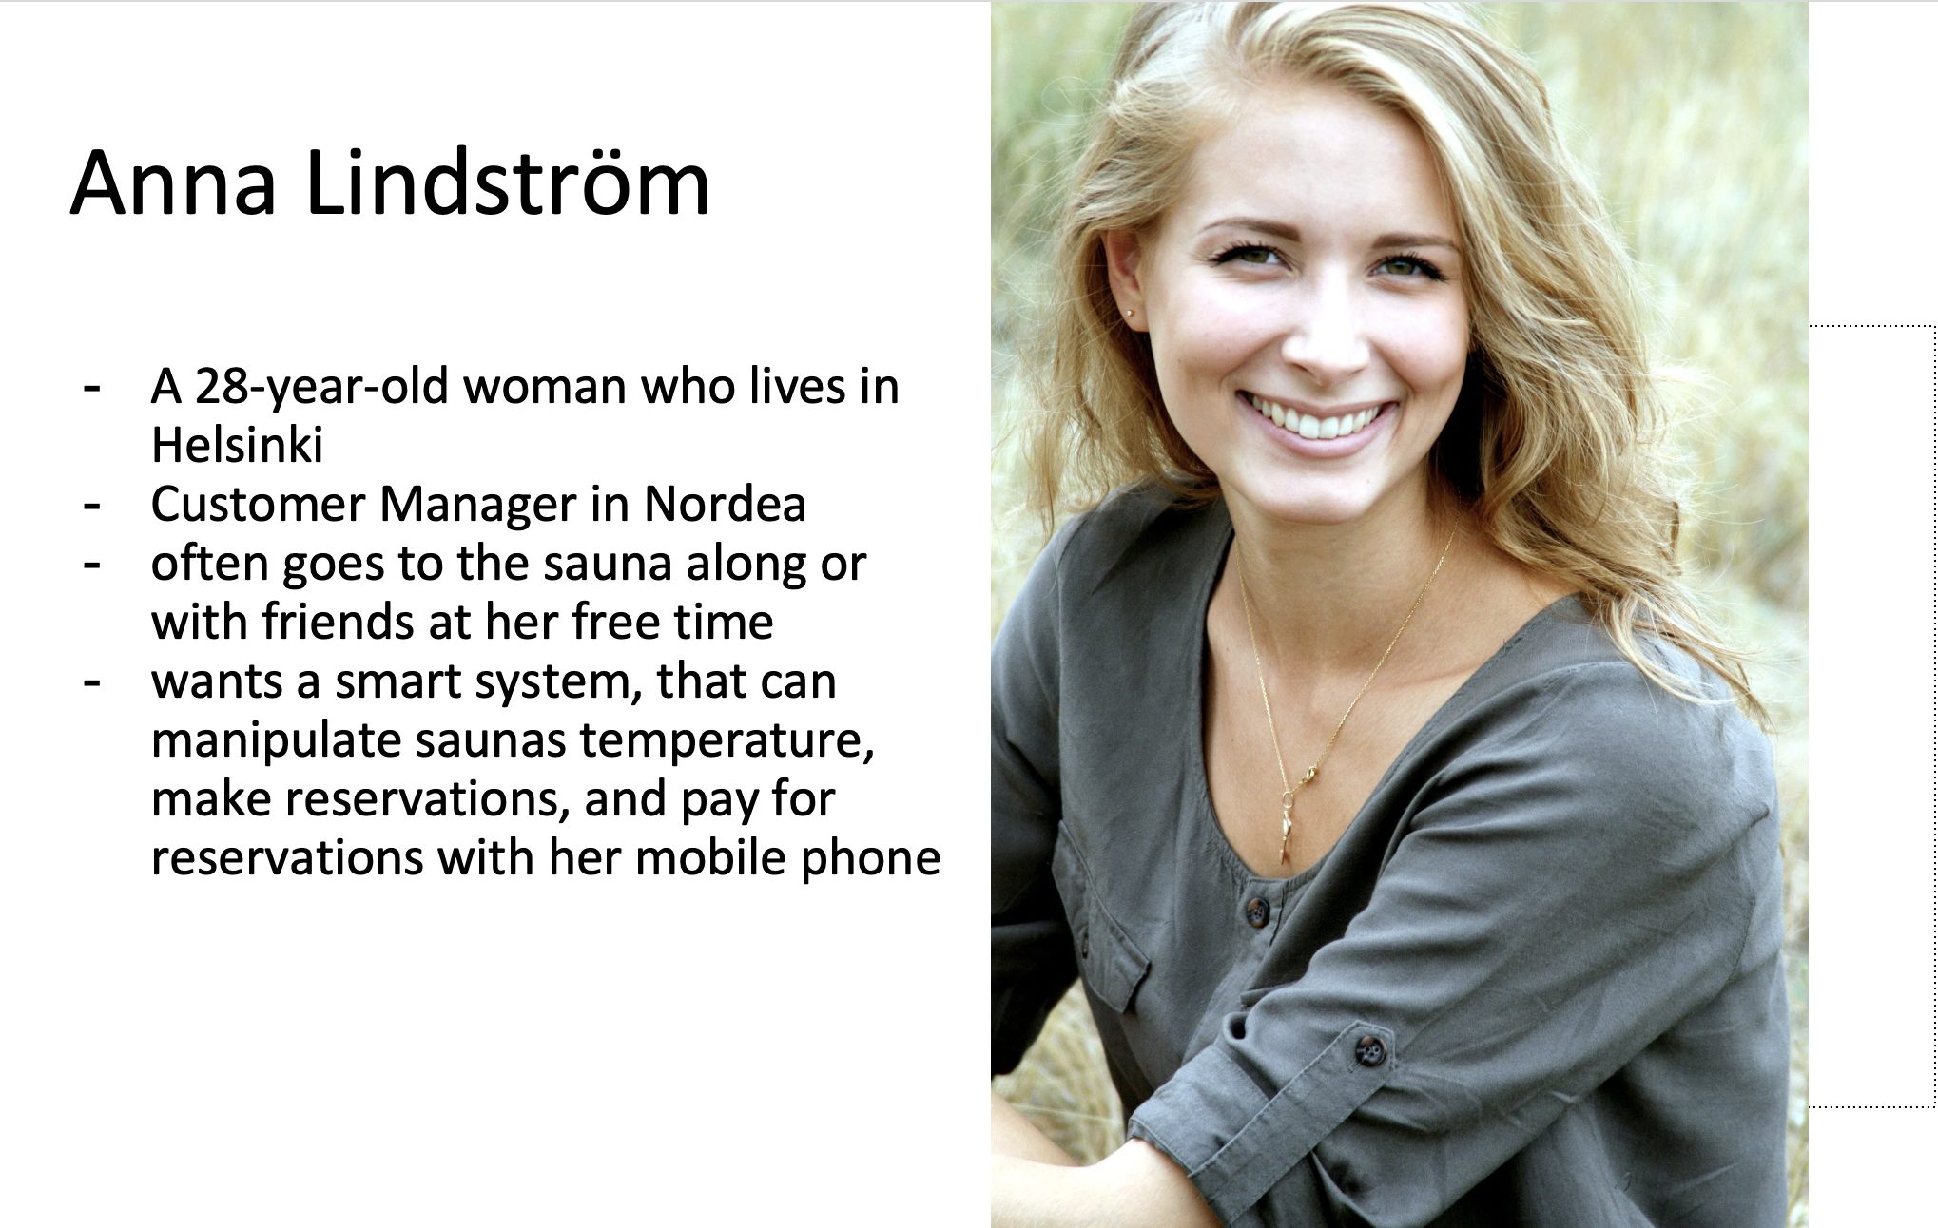
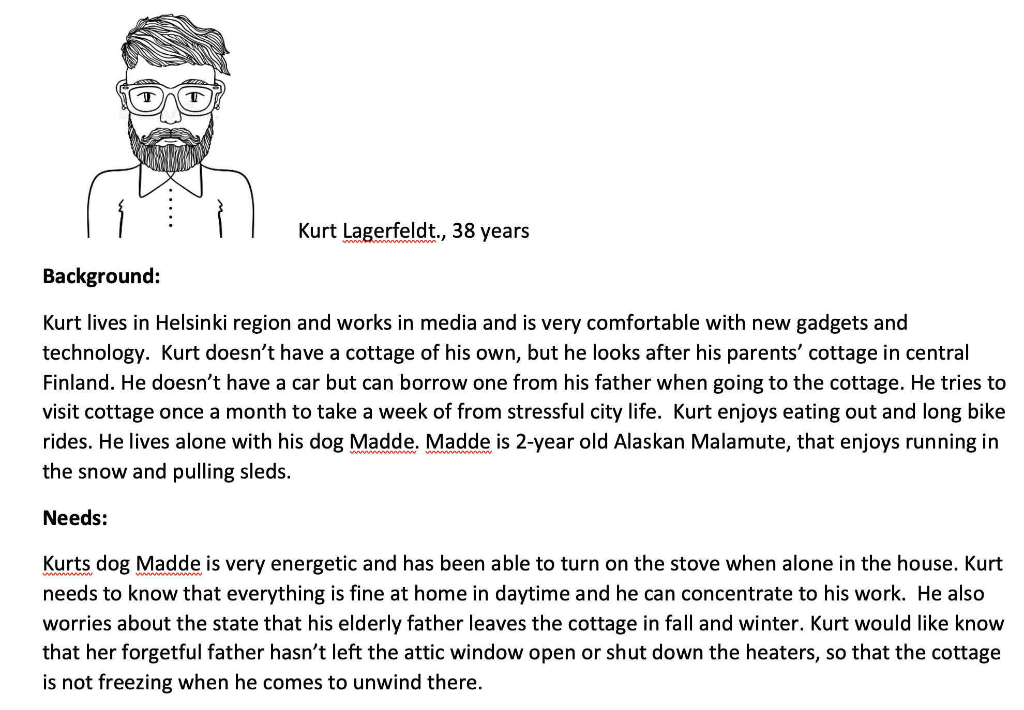
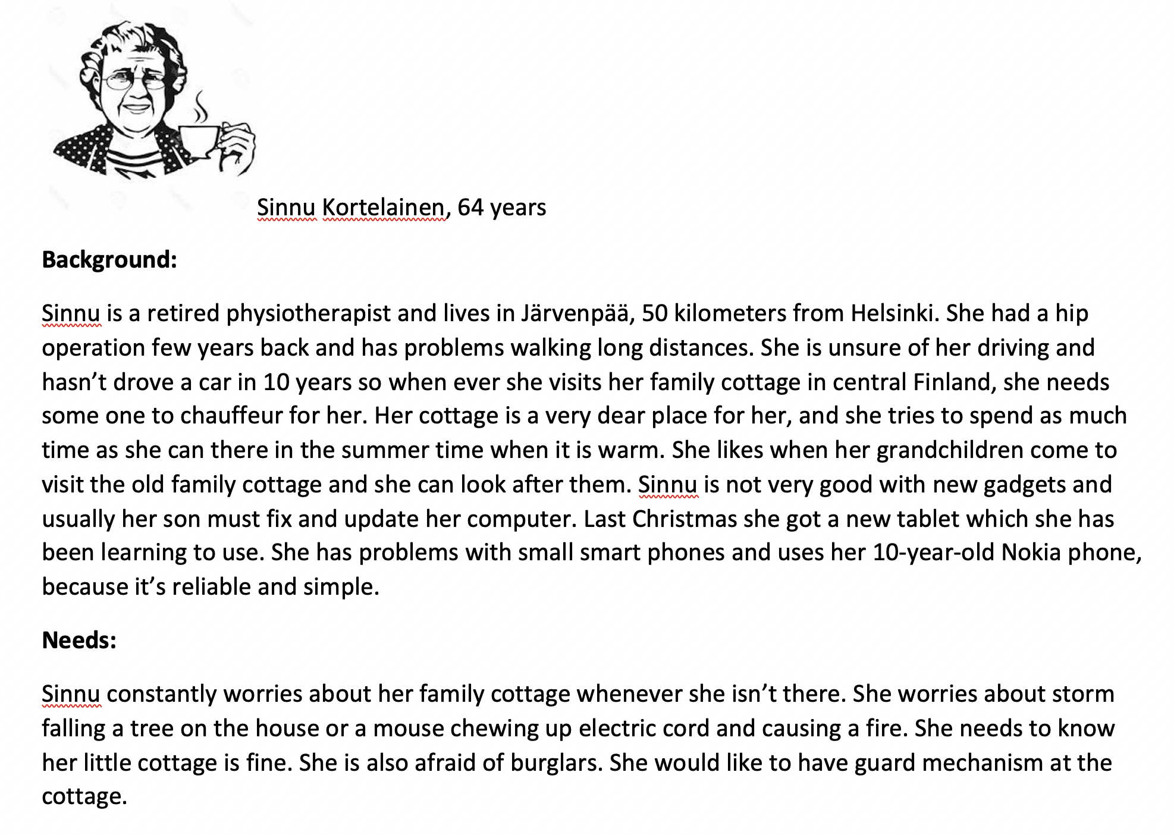
Sample personas

Slide 11
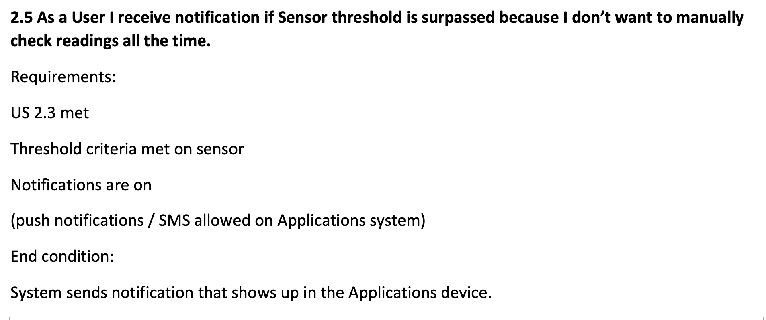
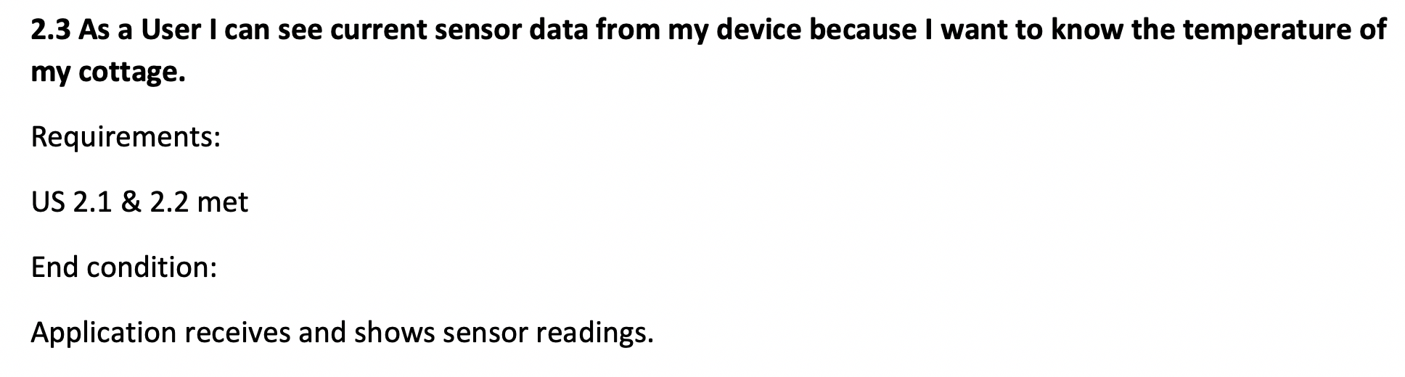
Sample user stories

Slide 12
Personas and user stories as tools for requirement capture
Idea -> identify user groups -> personas -> user stories -> product backlog
persona
Application idea
Product backlog
persona
persona

Slide 13
Backlog is more than a list of requirements...
Ordered / prioritised list of work to be done (work items)
user stories
business planning tasks
testing
bug fixes, changes, improvements
support tasks, learning
Order of the items is based on business value and on team's assessment of effort or complexity

Slide 14
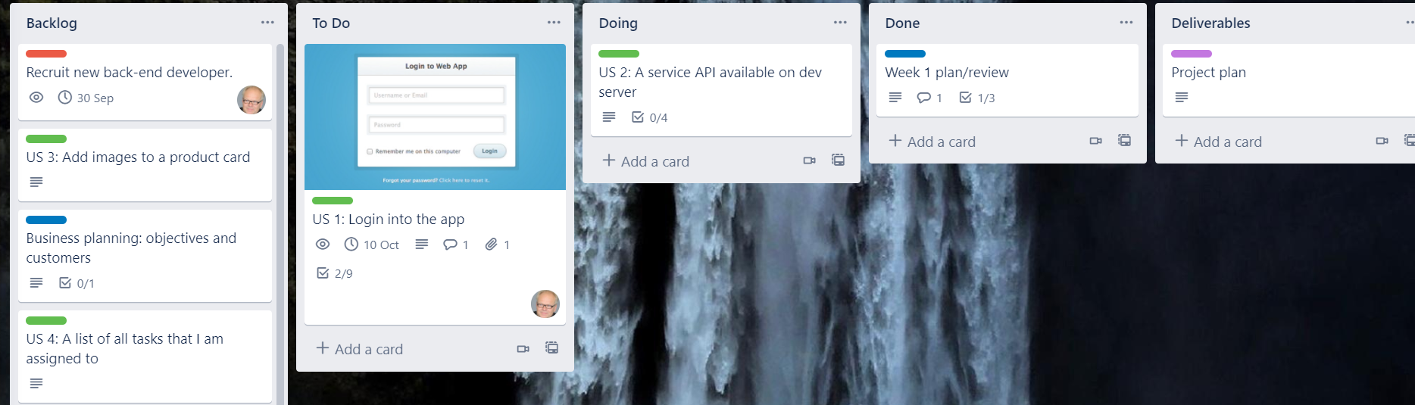
Working on the items in the backlog
Use e.g. Trello or MS planner to manage the project work
Pull high-priority backlog items into the worklist of a sprint (sprint backlog, todo-list, …)

Slide 15
Backlog swimlanes
Items in backlog are organized into lists - these lists are called “Swimlanes”
Usual swimlanes, or lists, (might) include:
Backlog, To Do, Doing, Done, Deliverable, Blocked, Released, Closed
… more or less as needed
When new tickets are created, they are first added to the Backlog swimlane
Tickets selected for the sprint will be moved to the To Do
From here the tickets follow the flow: To Do -> Doing -> Done -> Released
Therefore during the sprint only tickets from the To Do would be picked for development
Easy to see the velocity and current situation of the project with a glance

Slide 16
Backlog prioritization / ordering
Tickets can be prioritized / ordered in multiple ways
Business priorities / goals
Size of ticket
How many hours/days it takes to implement the ticket
Complexity of a ticket
Prioritization can be based on estimation
Planning poker
Individual estimates on the length of the task (best estimates)
Product Owner (PO) is responsible for keeping the backlog in order
Scrum Master and the development team will help the PO as much as possible
Resources:
https://en.wikipedia.org/wiki/Planning_poker

Slide 17
Sprints
A repeatable fixed time-frame dedicated for work, usually two weeks
For this course one week sprints would work best
Goal is to produce potentially shippable feature during the spring
Items from backlog are picked for the sprint
Sprint wraps all Scrum activities:
Sprints start with planning
Daily standups (daily scrums in literature)
Might have weekly standups with the whole organization
Completed features (the Done list) are demoed in Sprint review
Sprint ends with an Sprint retrospective
Between these activities, actual development work is done

Slide 18
Sprints
Sprints are commonly used in the software industry
As items for the sprint are picked, they will not change during the sprint
The backlog for the sprint is holy;
No new tickets will be added to the sprint
No tickets will change (fundamentally at least)
No tickets will be removed from the sprint (unless for a good reason)
As the backlog does not change during the sprint, developers will have the opportunity to really focus on their work

Slide 19
Sprints
Sprint lets everyone concentrate on their work
This way no unexpected situations should happen - not foolproof
Sprints & sprint backlog will let everyone know what the other people are working on and how much & how fast progress is done
Development speed or progress is called velocity
Links:
https://www.atlassian.com/agile/scrum/sprints
https://en.wikipedia.org/wiki/Kanban_(development)
https://medium.com/serious-scrum/the-sprint-backlog-ecf3505224fa
https://www.agilealliance.org/glossary/definition-of-done/
https://en.wikipedia.org/wiki/Scrum_Sprint

Slide 20
End

